Slide 1
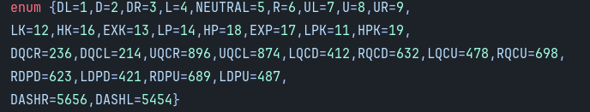

Slide 2
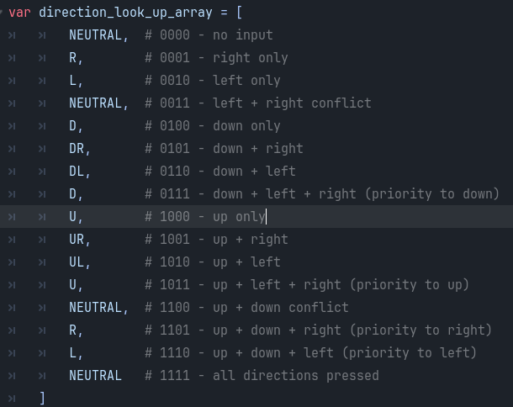
Managing inputs

Slide 3












Slide 4
Each input one at a time shown when i speak
N

Slide 5
N

Slide 6
N

Slide 7
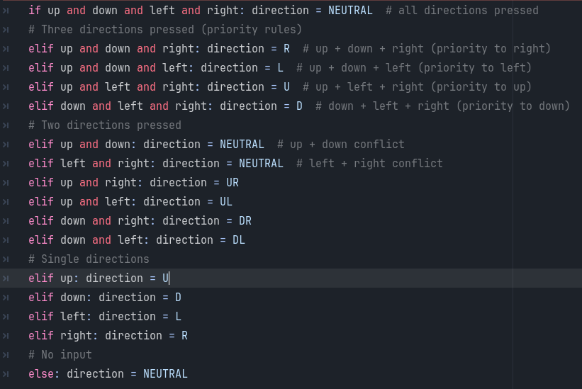
To do this in code 2 ways

Slide 8
7 8 9
4 5 6
1 2 3
UL U UR
L N R
DL D DR
N

Slide 9
Types of blocking
Images of sf6(regular and parry),smash bros

Slide 10
How blocking works

Slide 11
To do this in code

Slide 12
The subjective Projectile case

Slide 13
To do this in game engine

Slide 14
How to make an input manger fo fighting games

Slide 16
Each input one at a time shown when i speak
N

Slide 17
Add images V
Some attack
DQCF+LP
Some other attack
FDPD+LP
Some other other attack
DQCB e+HK

Slide 18
A scanner of the inputs showing when a code is valid slowly
oldest
N
N
N
N
N
N
N
Newest

Slide 19
A scanner of the inputs showing when a code is valid slowly and this time with gaps
oldest
N
N
N
Newest

